Slide 1
7 Testing Principles
Joel Robinson Feb 2019

Slide 2
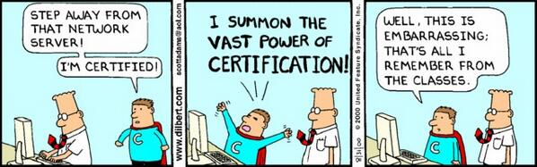

Slide 3
Sources: ISTQB
International Software Testing Qualifications Board
https://www.istqb.org/
605,000 certifications in 120 countries
Advance Career as Test Professional
Requires investment in time and money learning basics + advanced materials
Prove you are familiar with international testing language and standards
Download syllabus & documents:
https://www.istqb.org/

Slide 4
IEEE Sources
Codified Standards for Test Documentation and Software Reviews
IEEE 829 – 2008 Standard for Test Documentation Overview
IEEE 1028-2008 - IEEE Standard for Software Reviews and Audits
www.standards.ieee.org $160 each

Slide 5
IEEE Sources
Codified Standards for Test Terms and Conducting Tests
British Standard 7925-1 Software Testing Glossary
British Standard 7925-2 Software Component Testing Standard
http://www.testingstandards.co.uk/bs_7925-1.htm £ 126.00
http://www.testingstandards.co.uk/bs_7925-2.htm £ 246.0

Slide 6
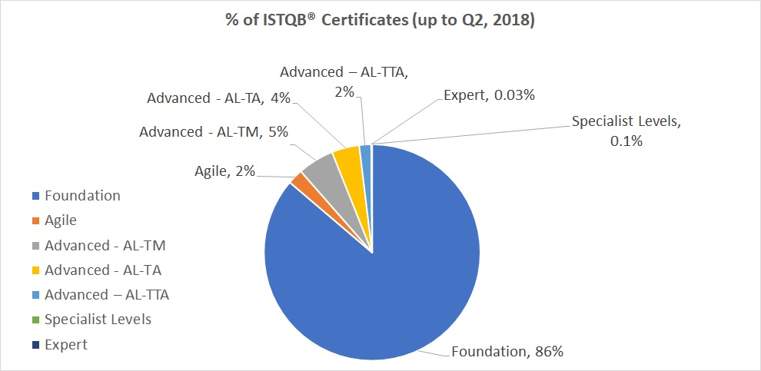
Types of Software Test Certifications

Slide 7
Boring!!!
The last thing you want me to do is to go over all areas on the standards and syllabus!
Trust me, it’s only cool if you are a test engineer.

Slide 8
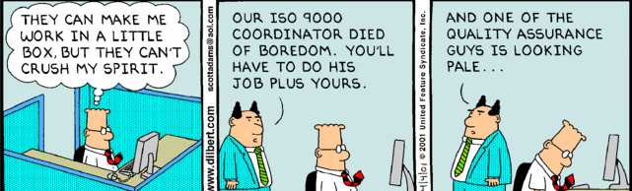

Slide 9
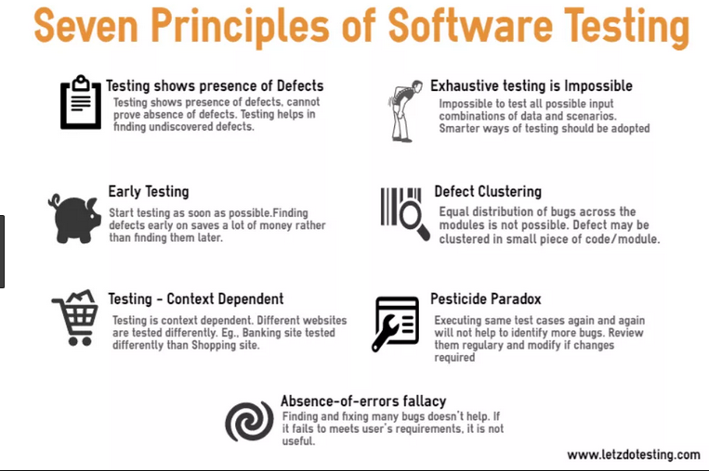

Slide 10
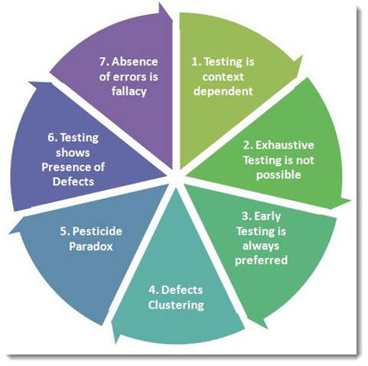
toolsqa.com

Slide 11
1. Exhaustive testing is impossible Yes! Exhaustive testing is not possible.
Instead, we need the optimal amount of testing based on the risk assessment of the application.
Test the most important things first.
www.guru99.com

Slide 12
2. Defect Clustering
Defect Clustering: a small number of modules contain most of the defects detected.
This is the application of the Pareto Principle to software testing: approximately 80% of the problems are found in 20% of the modules.
Spend your time predicting where defects are likely to be.
For that you need to consult Pythia, the high priestess of Apollo
from Delphi, Greece.
www.istqb.org

Slide 13
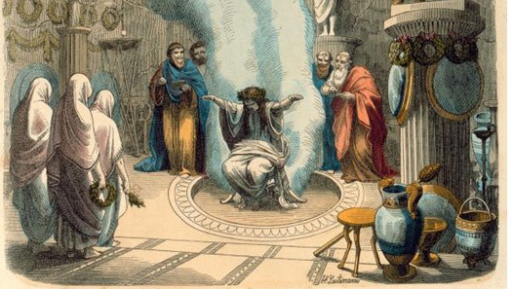

Slide 14

Pesticide Paradox Drawing by Joel Montvelisky, https://qablog.practitest.com

Slide 15
3. Pesticide Paradox
Repetitive use of the same pesticide mix to eradicate insects leads to the insects developing resistance to the pesticide.
The same applies to software testing. If the same set of repetitive tests are conducted, the method will be useless for discovering new defects.
4. Testing shows a presence of defects
Testing can show that defects are present, but cannot prove that there are no defects. Testing reduces
the probability of undiscovered defects remaining in the software but, even if no defects are found, testing is not a proof of correctness. www.istqb.org

Slide 16
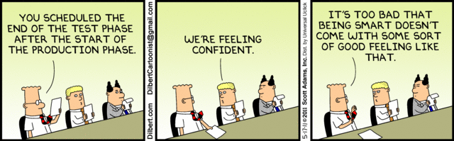
Early Testing

Slide 17
5. Early testing saves time and money
To find defects early, both static and dynamic test activities should be started as early as possible in the SW development lifecycle. Early testing is sometimes referred to as shift left. Testing early lowers costs.
www.istqb.org
6. Testing is context dependent
Testing is done differently in different contexts.
For example, safety-critical industrial control software is tested differently from an e-commerce mobile app.
Agile vs. waterfall.
Different company philosophies (start-up vs. HP)

Slide 18
7. Absence-of-errors is a fallacy
Some organizations expect that testers to run all possible tests and find all possible defects.
Many defects are in the requirements; producing the wrong product perfectly is still a defect.
www.istqb.org

Slide 19
Cool huh?
The end

